Slide 1
Word2Vec
Itay Hazan

Slide 2
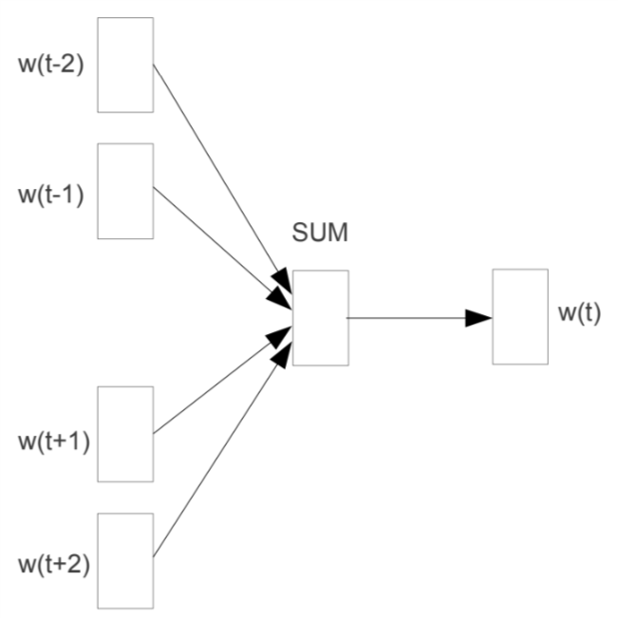
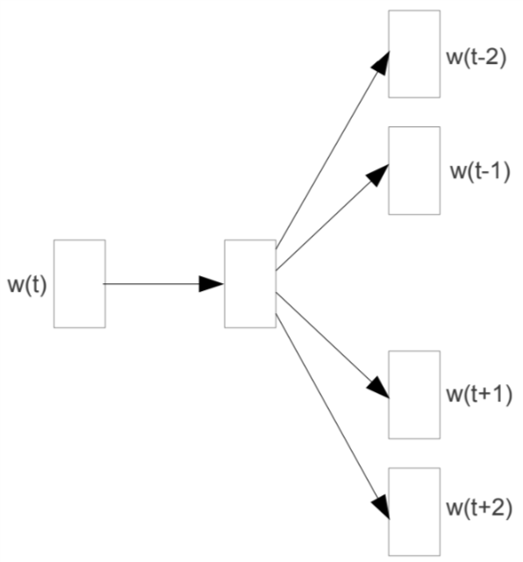
The Two Context Representations
Continuous Bag of Words (CBOW)
Skip-grams

Slide 3
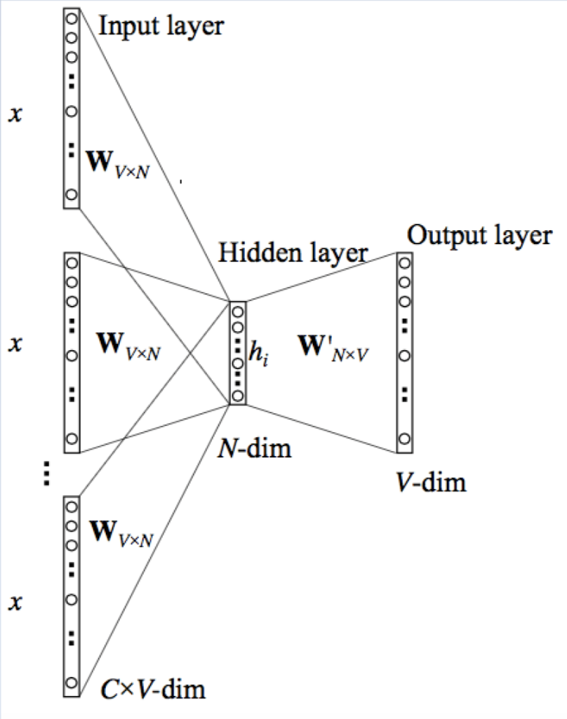
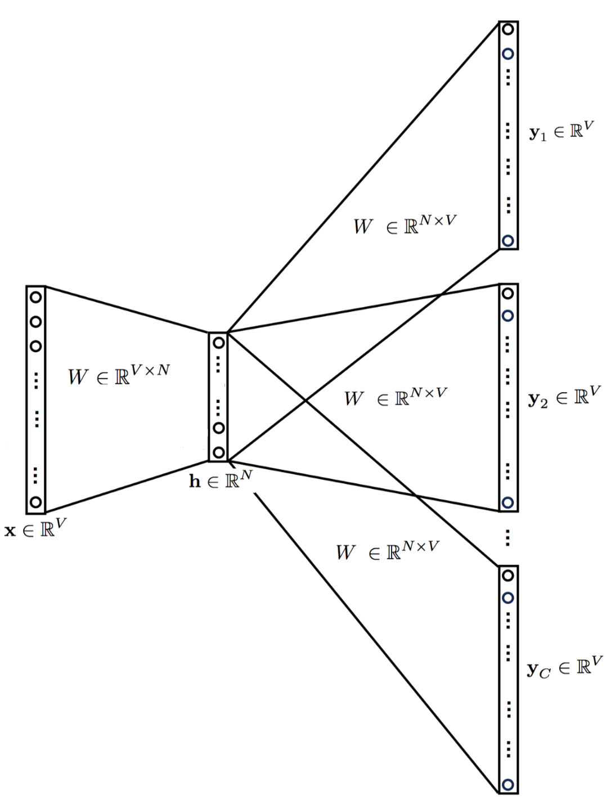
The Two Context Representations
Continuous Bag of Words (CBOW)
Skip-grams

